Slide 1
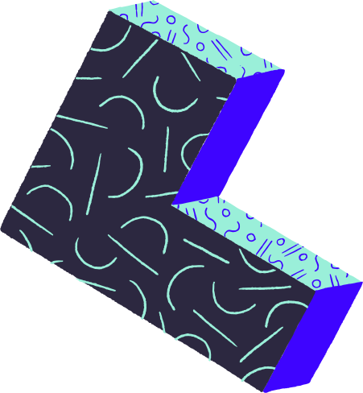
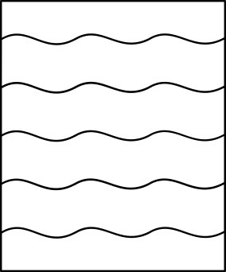


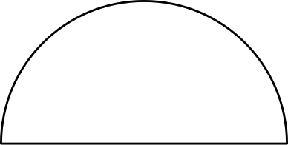
CSS 4 ADULTS
CSS
ES
MUY FINO

Slide 2

Topics
Preprocessors
Diagramming
Challenge / Demo
Responsiveness
PostCSS

Slide 3





PRE-PROCESSORS
A CSS preprocessor is a program that lets you generate CSS from the preprocessor's own unique syntax.
VARIABLES
Loops
Nesting 💖
Mixins
Extends
I'M DREAMING OF A
Color Operations
If/Else Statements
MATH
IMPORTS

Slide 4
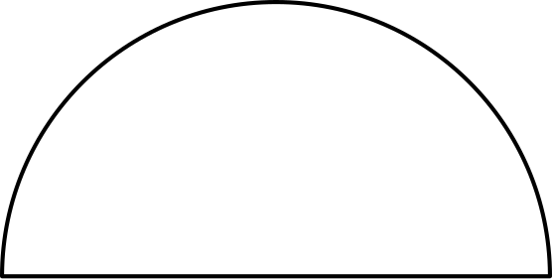
DIAGRAMMING
HTML
+
CSS
Flexbox
Grid

Slide 5
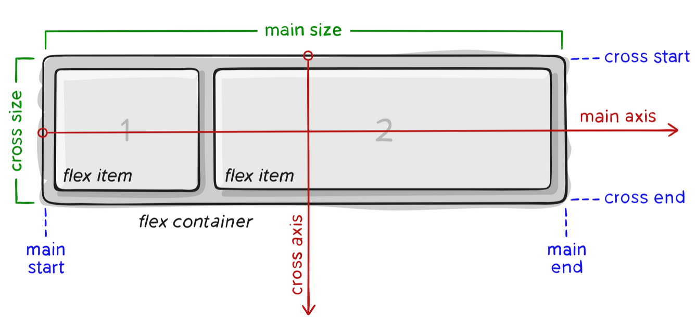
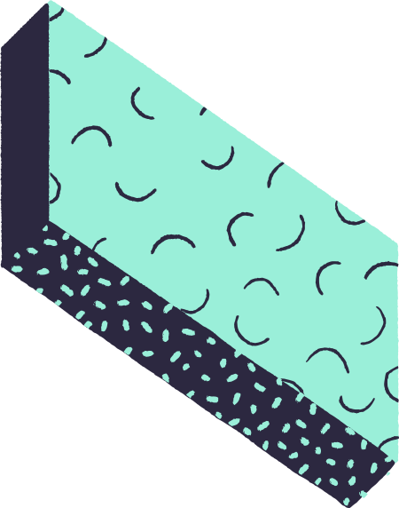
<flex-container>
FLEXBOX
Properties
display: flex
</flex-container>

Slide 6
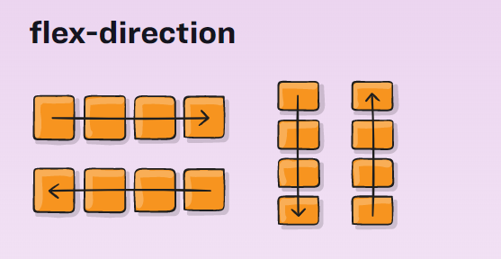
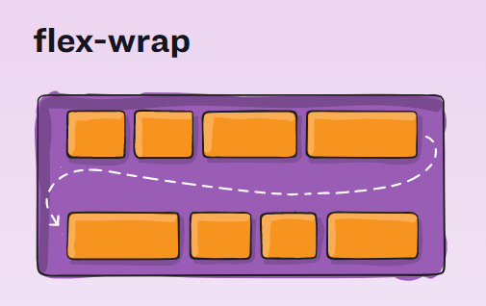
<flex-container>
FLEXBOX
Properties
flex-direction: establishes the main-axis
row | row-reverse | column | column-reverse
flex-wrap: should items fit in 1 line?
nowrap | wrap | wrap-reverse
flex-flow: flex-direction + flex-wrap
=> flex-flow: column wrap
</flex-container>

Slide 7
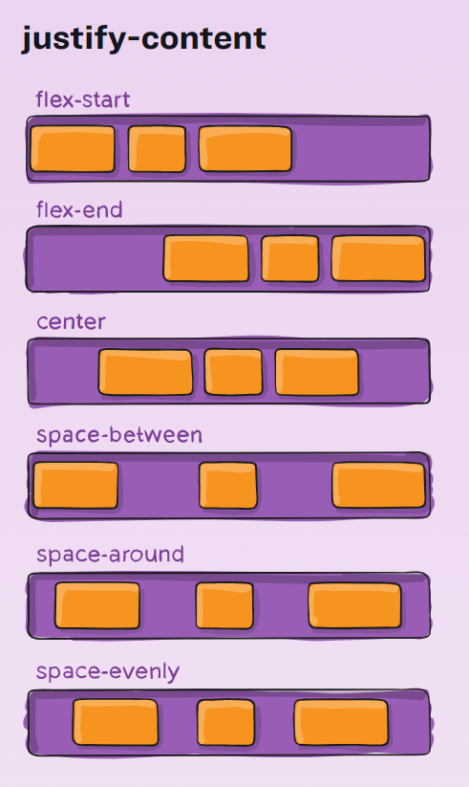
<flex-container>
FLEXBOX
Properties
justify-content: defines the alignment along the main axis
flex-start | flex-end | center | space-between | space-around | space-evenly | start | end | left | right ... + safe | unsafe;
</flex-container>

Slide 8
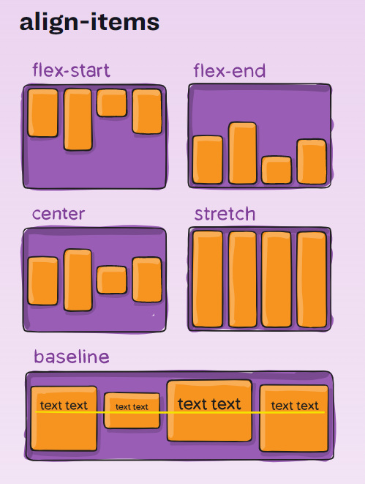
<flex-container>
FLEXBOX
Properties
align-items: defines the alignment along the cross axis
stretch | flex-start | flex-end | center | baseline | first baseline | last baseline | start | end | self-start | self-end + ... safe | unsafe;
</flex-container>

Slide 9
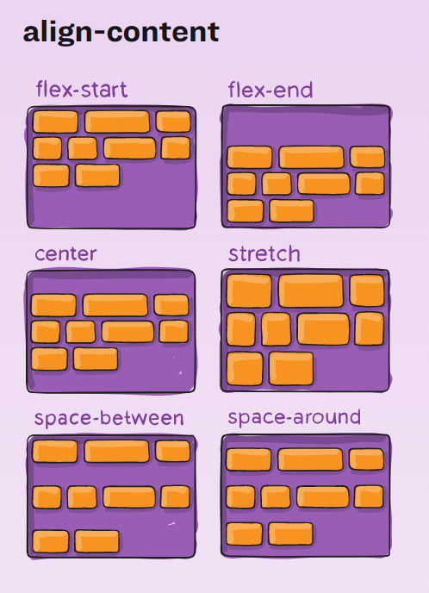
<flex-container>
FLEXBOX
Properties
align-content: aligns a flex container’s lines within when there is extra space in the cross-axis
flex-start | flex-end | center | space-between | space-around | space-evenly | start | end | left | right ... + safe | unsafe;
</flex-container>

Slide 10
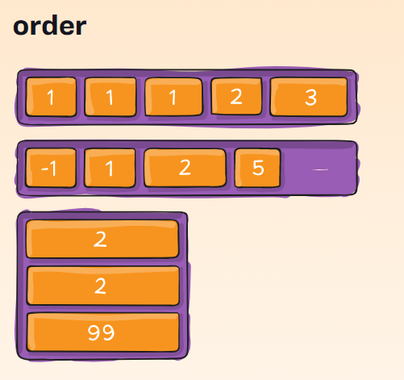
<flex-item>
FLEXBOX
Properties
order: custom order in which the item appears
order: 5
</flex-item>

Slide 11
<flex-item>
FLEXBOX
Properties
flex-grow: defines the ability and "velocity" to grow
flex-grow: 3
flex-shrink: defines the ability and "velocity" to shrink
flex-shrink: 2
flex-basis: the width of a row element
| auto
flex: flex-grow + flex-shrink + flex-basis
none | [ <'flex-grow'> <'flex-shrink'>? || <'flex-basis'> ]
flex: 1
</flex-item>

Slide 12
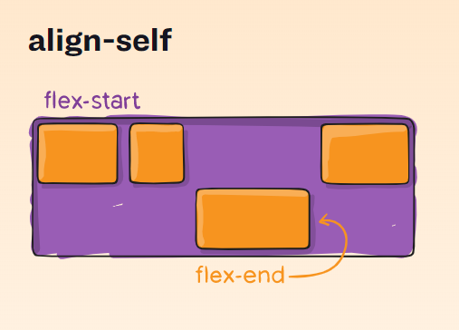
<flex-item>
FLEXBOX
Properties
align-self: This allows the default alignment in the cross axis to be overridden
auto | flex-start | flex-end | center | baseline | stretch;
</flex-item>

Slide 13
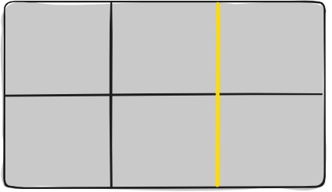
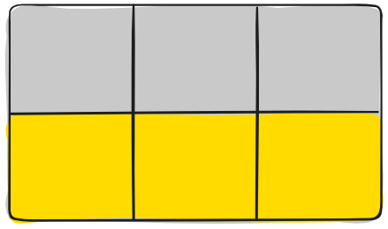
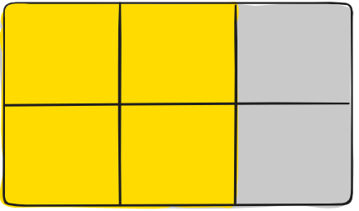
<grid-container>
GRID
Properties
display: grid
Grid Line
Grid Track
Grid Area
The dividing lines that make up the structure of the grid (horizontal or vertical)
The space between two adjacent grid lines
The total space surrounded by four grid lines
</grid-container>

Slide 14
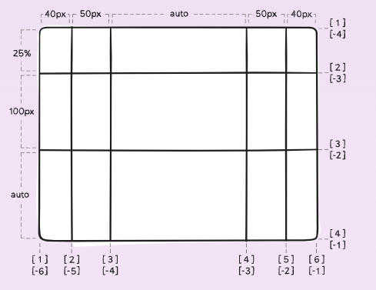
<grid-container>
GRID
Properties
grid-template-columns:
grid-template-rows:
Defines the columns and rows of the grid with a space-separated list of values. The values represent the track size, and the space between them represents the grid line.
The track size can be a length, a percentage, or a fraction of the free space in the grid (using the fr unit). Commonly used with the repeat function: repeat(3, 1fr).
grid-template-columns: 40px 50px auto 50px 40px;
grid-template-rows: 25% 100px auto;
</grid-container>

Slide 15
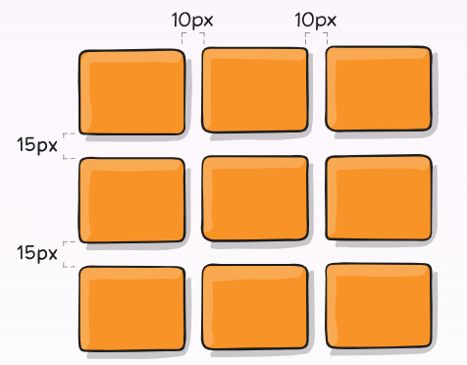
<grid-container>
GRID
Properties
column-gap:
row-gap:
Specifies the size of the grid lines. Width of the gutter.
gap: column-gap + row-gap
gap: 3px
grid-template-columns: repeat(3, 1fr);
column-gap: 10px;
row-gap: 15px;
</grid-container>

Slide 16
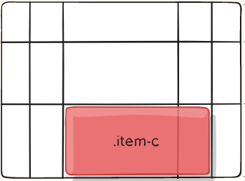
<grid-item>
GRID
Properties
grid-column-start:
grid-column-end:
grid-row-start:
grid-row-end:
grid-column:
grid-row:
start / end
Determines the item's grid position by referring to a grid line
grid-column: 3 / span 2;
grid-row: 3 / 4;
</grid-item>

Slide 17

?????
SO... WHICH ONE SHOULD I USE??
?????
FLEX OR GRID ????
WHEN??? WHY?? ONLY 1 FOR PROJECT??
?????
?????

Slide 18
FLEX
+
GRID

Slide 19
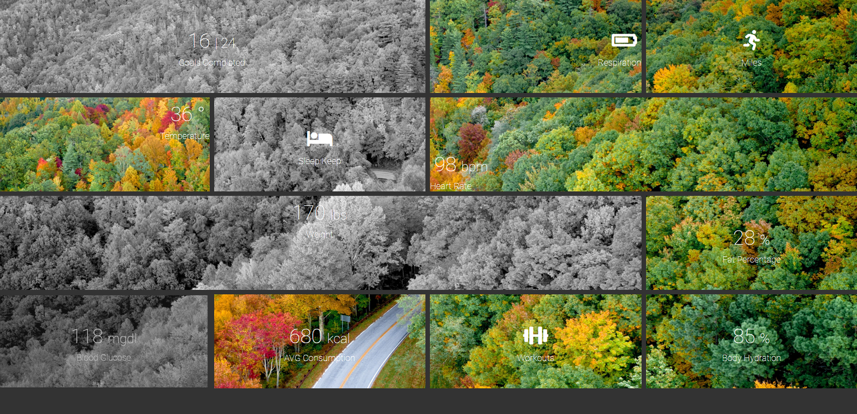
💪
CHALLENGE

Slide 20

RESPONSIVENESS
Media Queries
@media not|only mediatype and (mediafeature and|or|not mediafeature) { CSS-Code;
}
@media only screen and (max-width: 600px) {
body { background-color: lightblue; }
}
It uses the @media rule to include a block of CSS properties only if a certain condition is true.
Media queries can be used to check many things, such as: width and height of the viewport, width and height of the device, orientation and resolution.

Slide 21

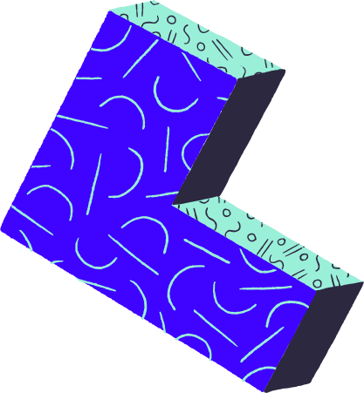
POSTCSS
PostCSS is a tool for transforming styles with JS plugins. These plugins can lint your CSS, support variables and mixins, transpile future CSS syntax, inline images, and more.
It takes a CSS file and provides an API to analyze and modify its rules (by transforming them into an Abstract Syntax Tree). This API can then be used by plugins to do a lot of useful things, e.g. to find errors automatically insert vendor prefixes.

Slide 22


tailwindcss

